Slide 1
Introduction to HTML

Slide 2
Objectives
What is HTML
HTML Structure
Web Browser
Doctype Declaration
HTML Versions
HTML Writing Syntax

Slide 3

What is HTML?
HTML is a markup language for describing web documents (web pages).
HTML stands for Hyper Text Markup Language
A markup language is a set of markup tags
HTML documents are described by HTML tags
Each HTML tag describes different document content

Slide 4
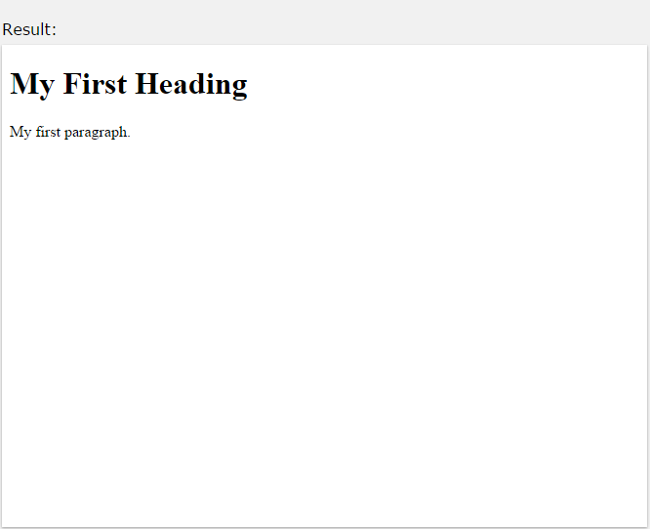
What is HTML?
A small HTML document:
<!DOCTYPE html>
<html>
<head>
<title>Page Title</title>
</head>
<body>
<h1>My First Heading</h1>
<p>My first paragraph.</p>
</body>
</html>

Slide 5
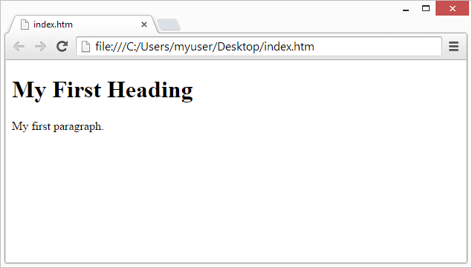
Web Browsers
The purpose of a web browser (Chrome, IE, Firefox, Safari) is to read HTML documents and display them.
The browser does not display the HTML tags, but uses them to determine how to display the document:

Slide 6
HTML Page Structure
Below is a visualization of an HTML page structure:
<html>
<head>
<title>Page title</title>
</head>
<body>
<h1>This is a heading</h1>
<p>This is a paragraph.</p>
<p>This is another paragraph.</p>
</body>

Slide 7
The <!DOCTYPE> Declaration.
The <!DOCTYPE> declaration helps the browser to display a web page correctly.
There are | different | document types on | the web.To | display a
document | correctly, | the browser must | know both | type and
version.
The doctype declaration is not case sensitive. All cases are acceptable:
<!DOCTYPE html>
<!DOCTYPE HTML>
<!doctype html>
<!Doctype Html>

Slide 8
Common Declarations
HTML5
<!DOCTYPE html>
HTML 4.01
<!DOCTYPE HTML PUBLIC "-//W3C//DTD HTML 4.01
Transitional//EN" "http://www.w3.org/TR/html4/loose.dtd">
XHTML 1.0
<!DOCTYPE html PUBLIC "-//W3C//DTD XHTML 1.0
Transitional//EN" "http://www.w3.org/TR/xhtml1/DTD/xhtml1- transitional.dtd">

Slide 9
HTML Versions.
Since the early days of the web, there have been many versions of HTML:
Version | Year
HTML | 1991
HTML 2.0 | 1995
HTML 3.2 | 1997
HTML 4.01 | 1999
XHTML | 2000
HTML5 | 2014
10

Slide 10
HTML Elements
HTML documents are made up by HTML elements.
Start tag and end tag
HTML elements are written with a start tag, with an end tag, with the content in between:
<tagname>content</tagname>
The HTML element is everything from the start tag to the end tag:
<p>My first HTML paragraph.</p>

Slide 11

Start tag and end tag
Start tag | Element content | End tag
<h1> | My First Heading | </h1>
<p> | My first paragraph. | </p>
<br>
Some HTML elements do not have an end tag.

Slide 12
Nested HTML Elements
HTML elements can be nested (elements can contain elements). All HTML documents consist of nested HTML elements.
This example contains 4 HTML elements:

Slide 13
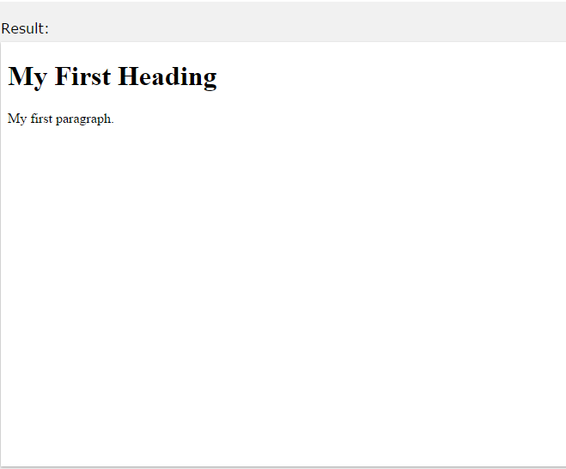
Nested HTML Elements
Example
<!DOCTYPE html>
<html>
<body>
<h1>My First Heading</h1>
<p>My first paragraph.</p>
</body>
</html>

Slide 14
Nested HTML Elements
The <body> element defines the document body. It has a start tag <body> and an end tag </body>.
The element content is two other HTML elements (<h1> and
<p>).
<body>
<h1>My First Heading</h1>
<p>My first paragraph.</p>
</body>

Slide 15
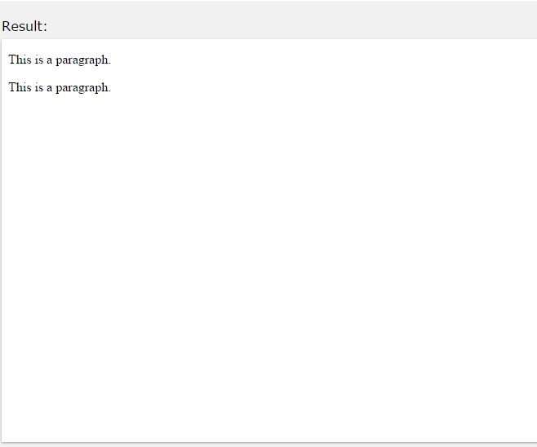
Don't Forget the End Tag
Some HTML elements will display correctly, even if you forget the end tag:
<html>
<body>
<p>This is a paragraph
<p>This is a paragraph
</body>
</html>
The example above works in all browsers, because the closing tag is considered optional.
Never rely on this. It might produce unexpected results and/or errors if you forget the end tag.

Slide 16
Empty HTML Elements
HTML elements with no content are called empty elements.
<br> is an empty element without a closing tag (the <br> tag defines a line break).
Empty elements can be "closed" in the opening tag like this: <br/>.
HTML5 does not require empty elements to be closed. But if you want stricter validation, or you need to make your document readable by XML parsers, you should close all HTML elements.

Slide 17
Use Lowercase Tags
HTML tags are not case sensitive: <P> means the same as <p>.
The HTML5 standard does not W3C recommends lowercase
require lowercase tags, but in HTML4,
and demandslowercase for stricter document types like XHTML.

Slide 18
HTML Attributes
Attributes provide additional information about HTML elements.
HTML elements can have attributes
Attributes provide additional information about an element
Attributes are always specified in the start tag
Attributes come in name/value pairs like: name="value"
<p title="About W3Schools">
W3Schools is a web developer's site.
It provides tutorials and references covering many aspects of web programming,
including HTML, CSS, JavaScript, XML, SQL, PHP, ASP, etc.
</p>

Slide 19
HTML Attributes
We Suggest: Always Use Lowercase Attributes
HTML5 standard does not require lower case
attribute
names.
The title attribute can be written with upper or lower case like Title and/or TITLE.
W3C recommends lowercase in HTML4,
and demands lowercase for stricter document types like XHTML.
We Suggest: Always Quote Attribute Values
The HTML5 standard does not require quotes around attribute values.
The href attribute, demonstrated above, can be written as:

Slide 20
Single or Double Quotes?
Double style quotes are the most common in HTML, but single style can also be used.
In some situations, when the attribute value itself contains double quotes, it is necessary to use single quotes:
<p title='John "ShotGun" Nelson'>
Or vice versa:
<p title="John 'ShotGun' Nelson">
30

